Slide 1
Python - Recursion
Premanand S

Slide 2
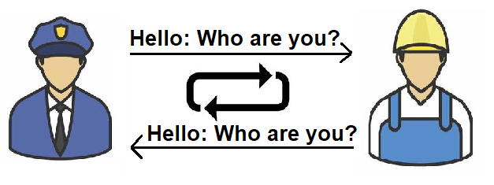
Recursion? layman

Slide 3
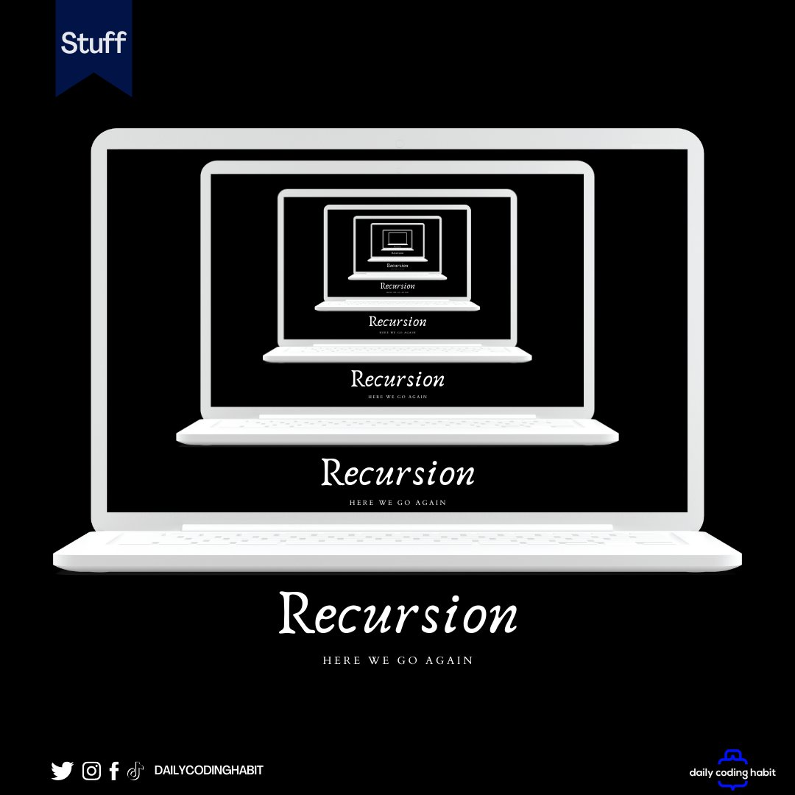
Recursion

Slide 4
Recursion
When a function call itself directly or indirectly
Why? - Sometime it is required to call same function on another set of data – Saves time
Understanding - place two parallel mirrors facing each other. Any object in between them would be reflected recursively

Slide 5
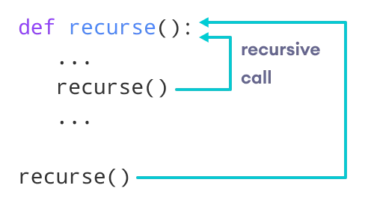
Flow of recursion

Slide 6
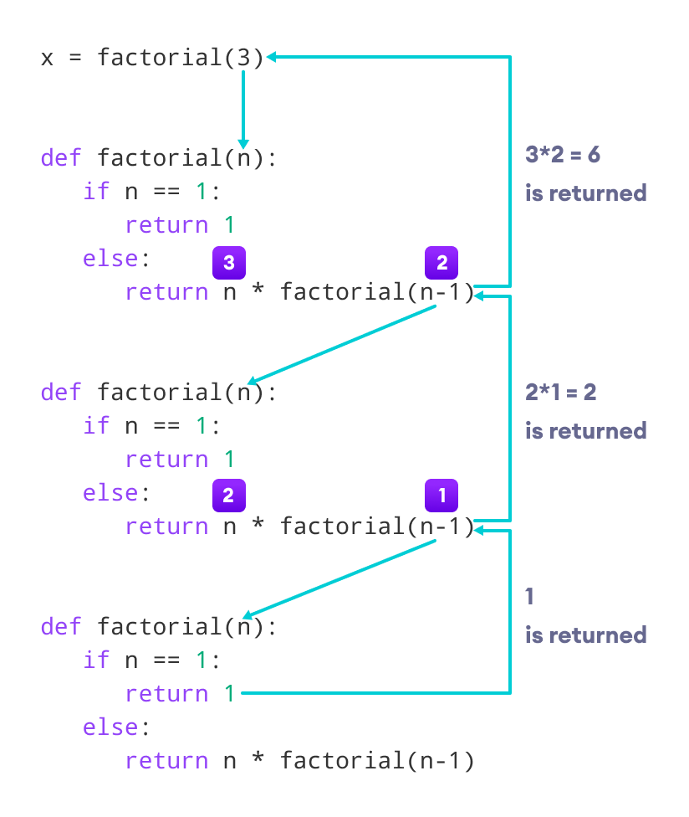
How it works? - factorial

